Slide 1
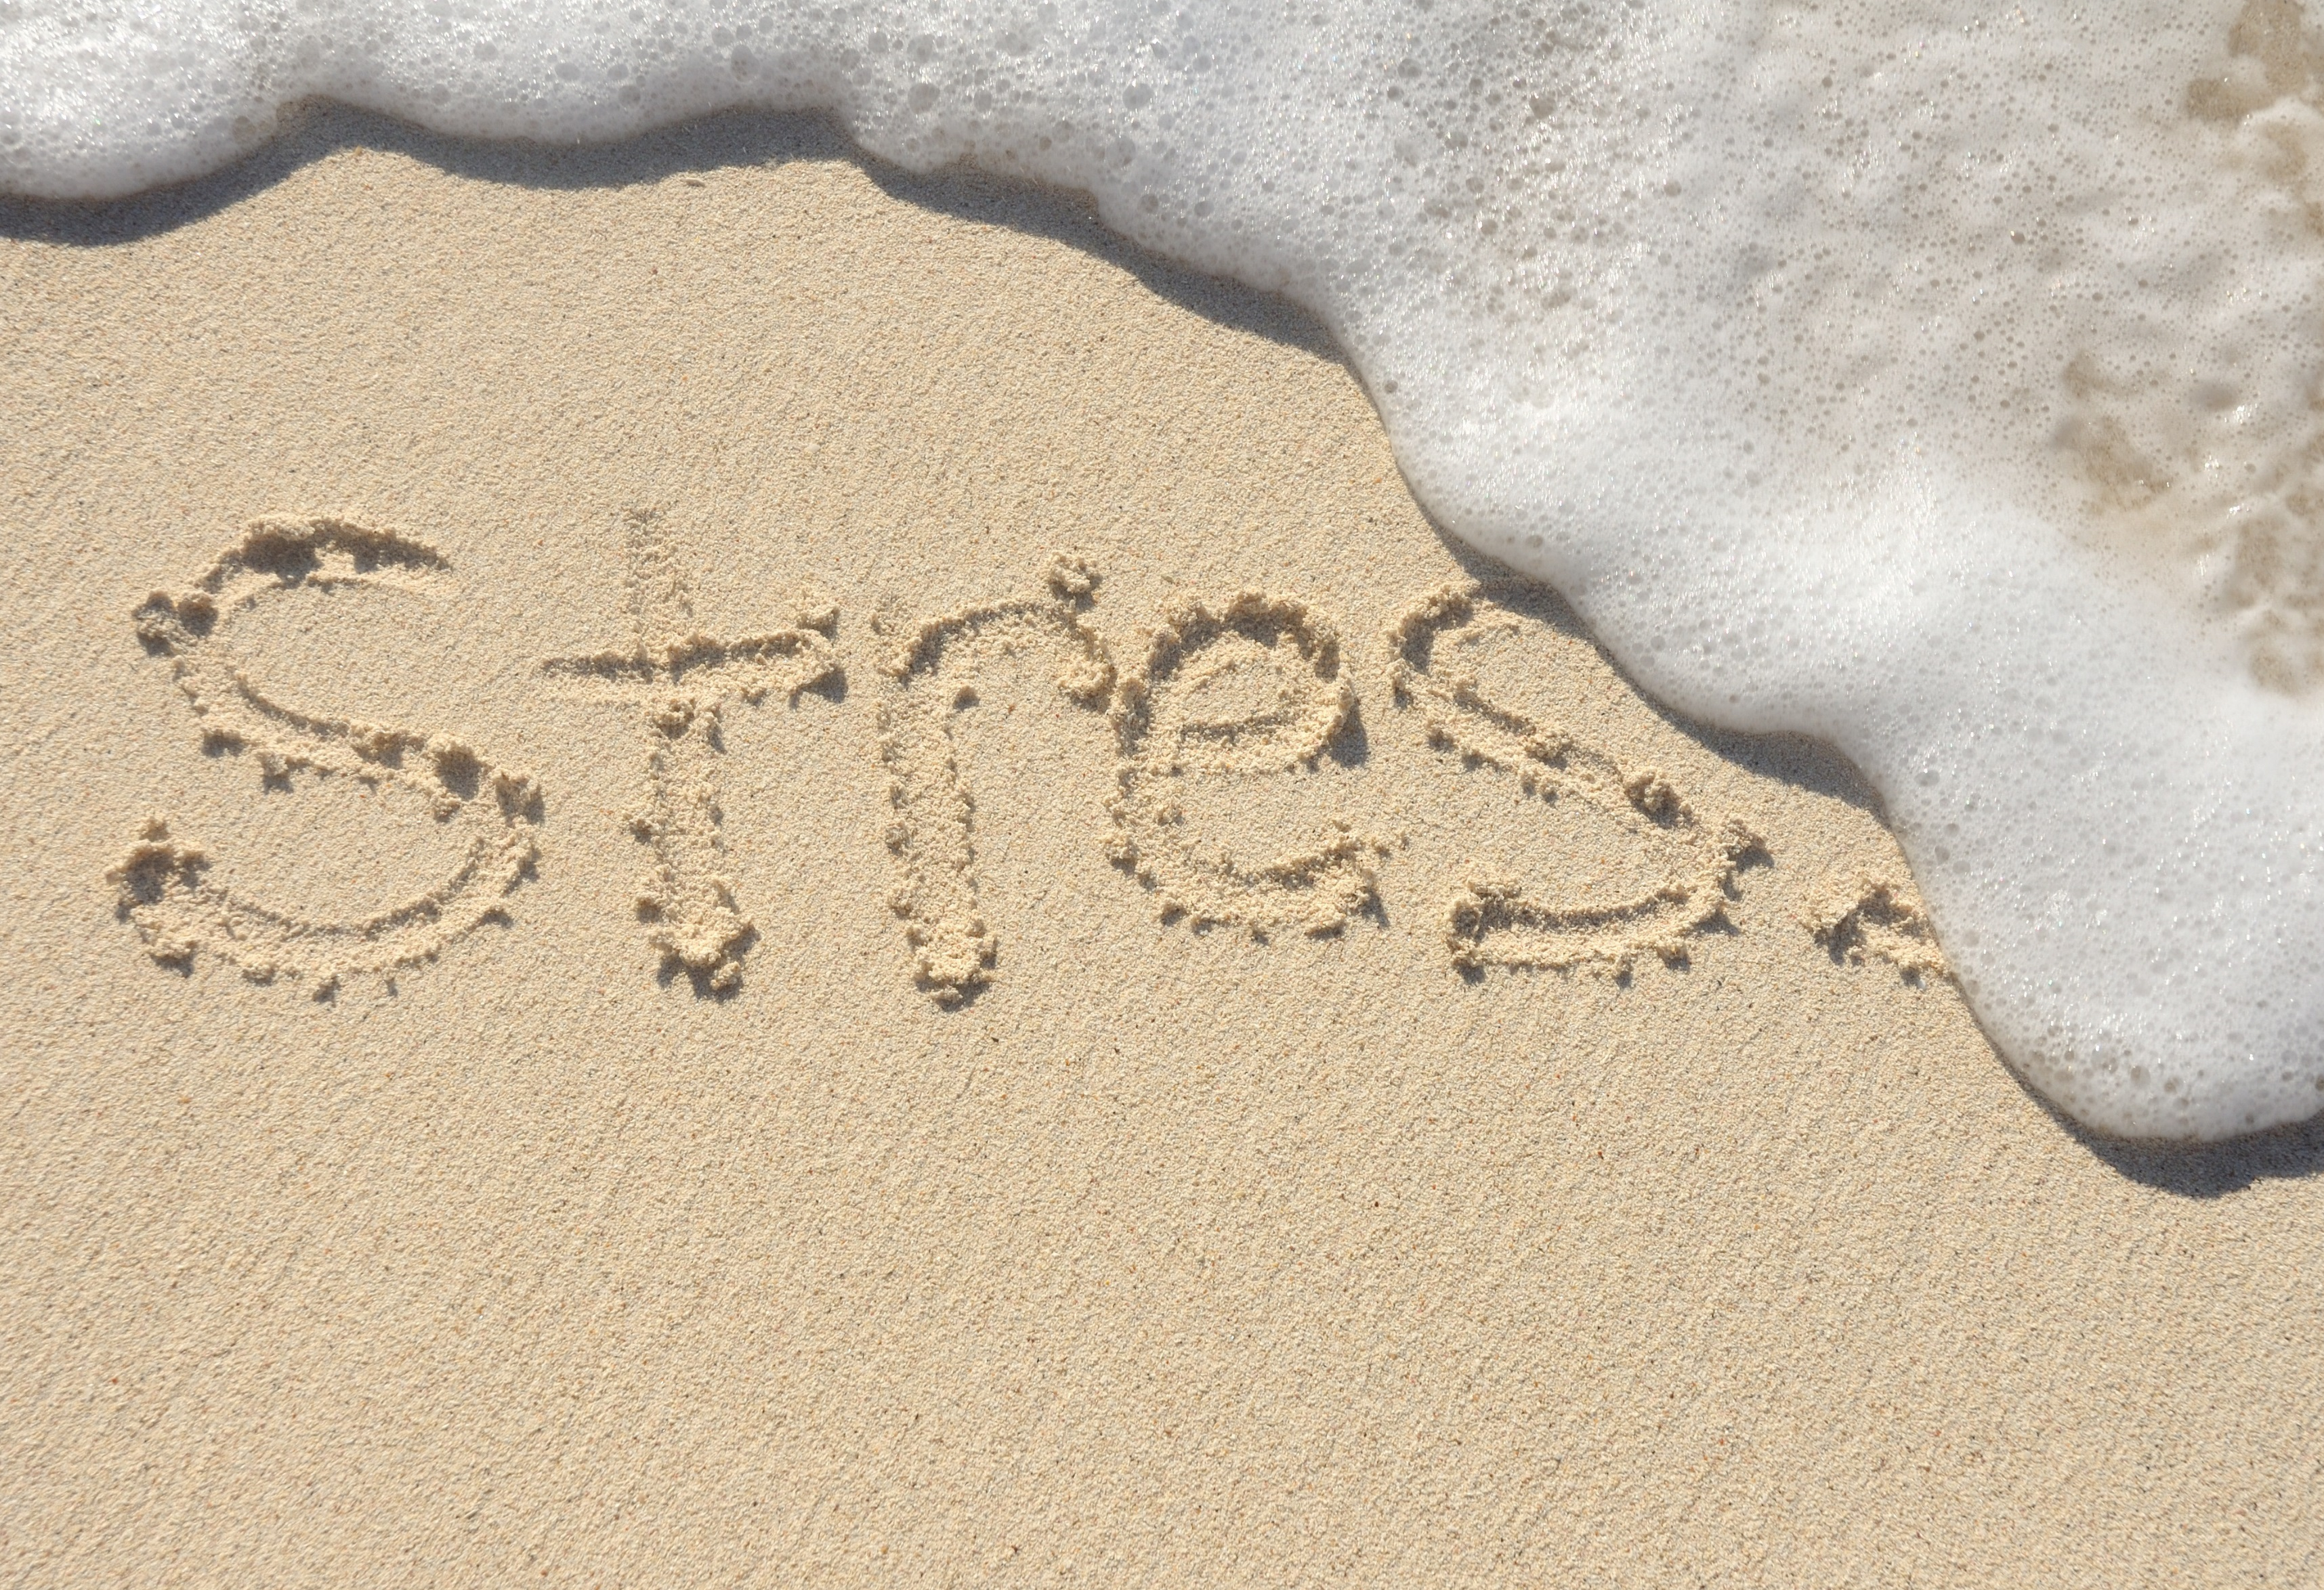
April is National Stress Awareness Month
How to Deal with
Stress and Anxiety:
Take deep breaths
Slowly count to 10
Give back to your community
Meditate, Pray
Get help online
Talk to someone

