Slide 1
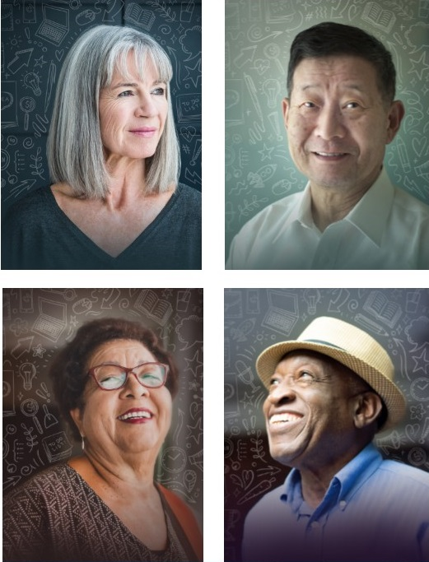
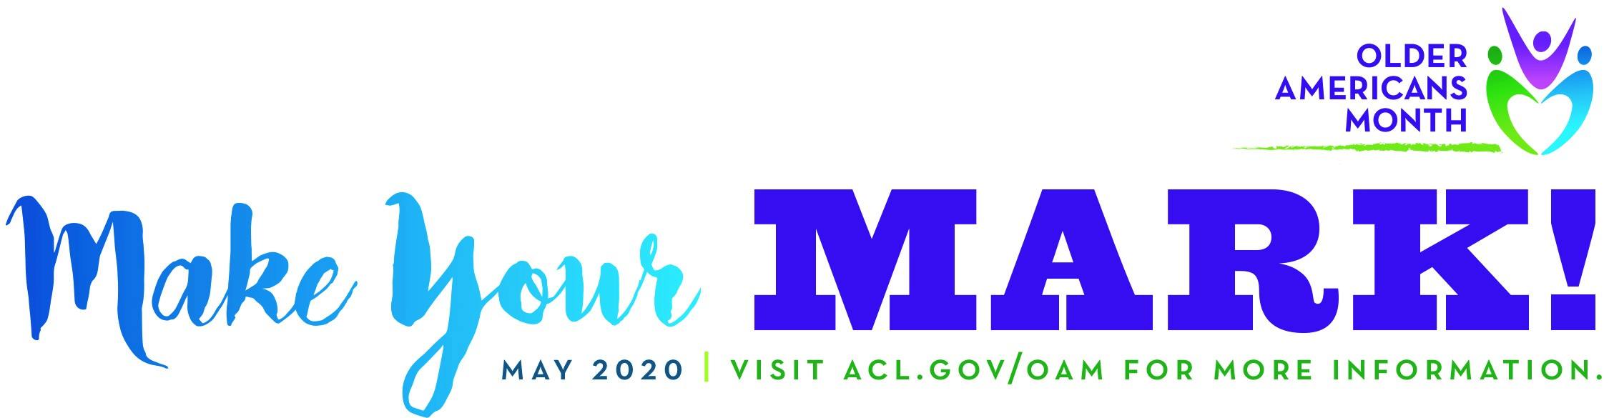
May is Older Americans Month
Celebrating older adults’ unique and lasting contributions to their communities.

