Slide 1
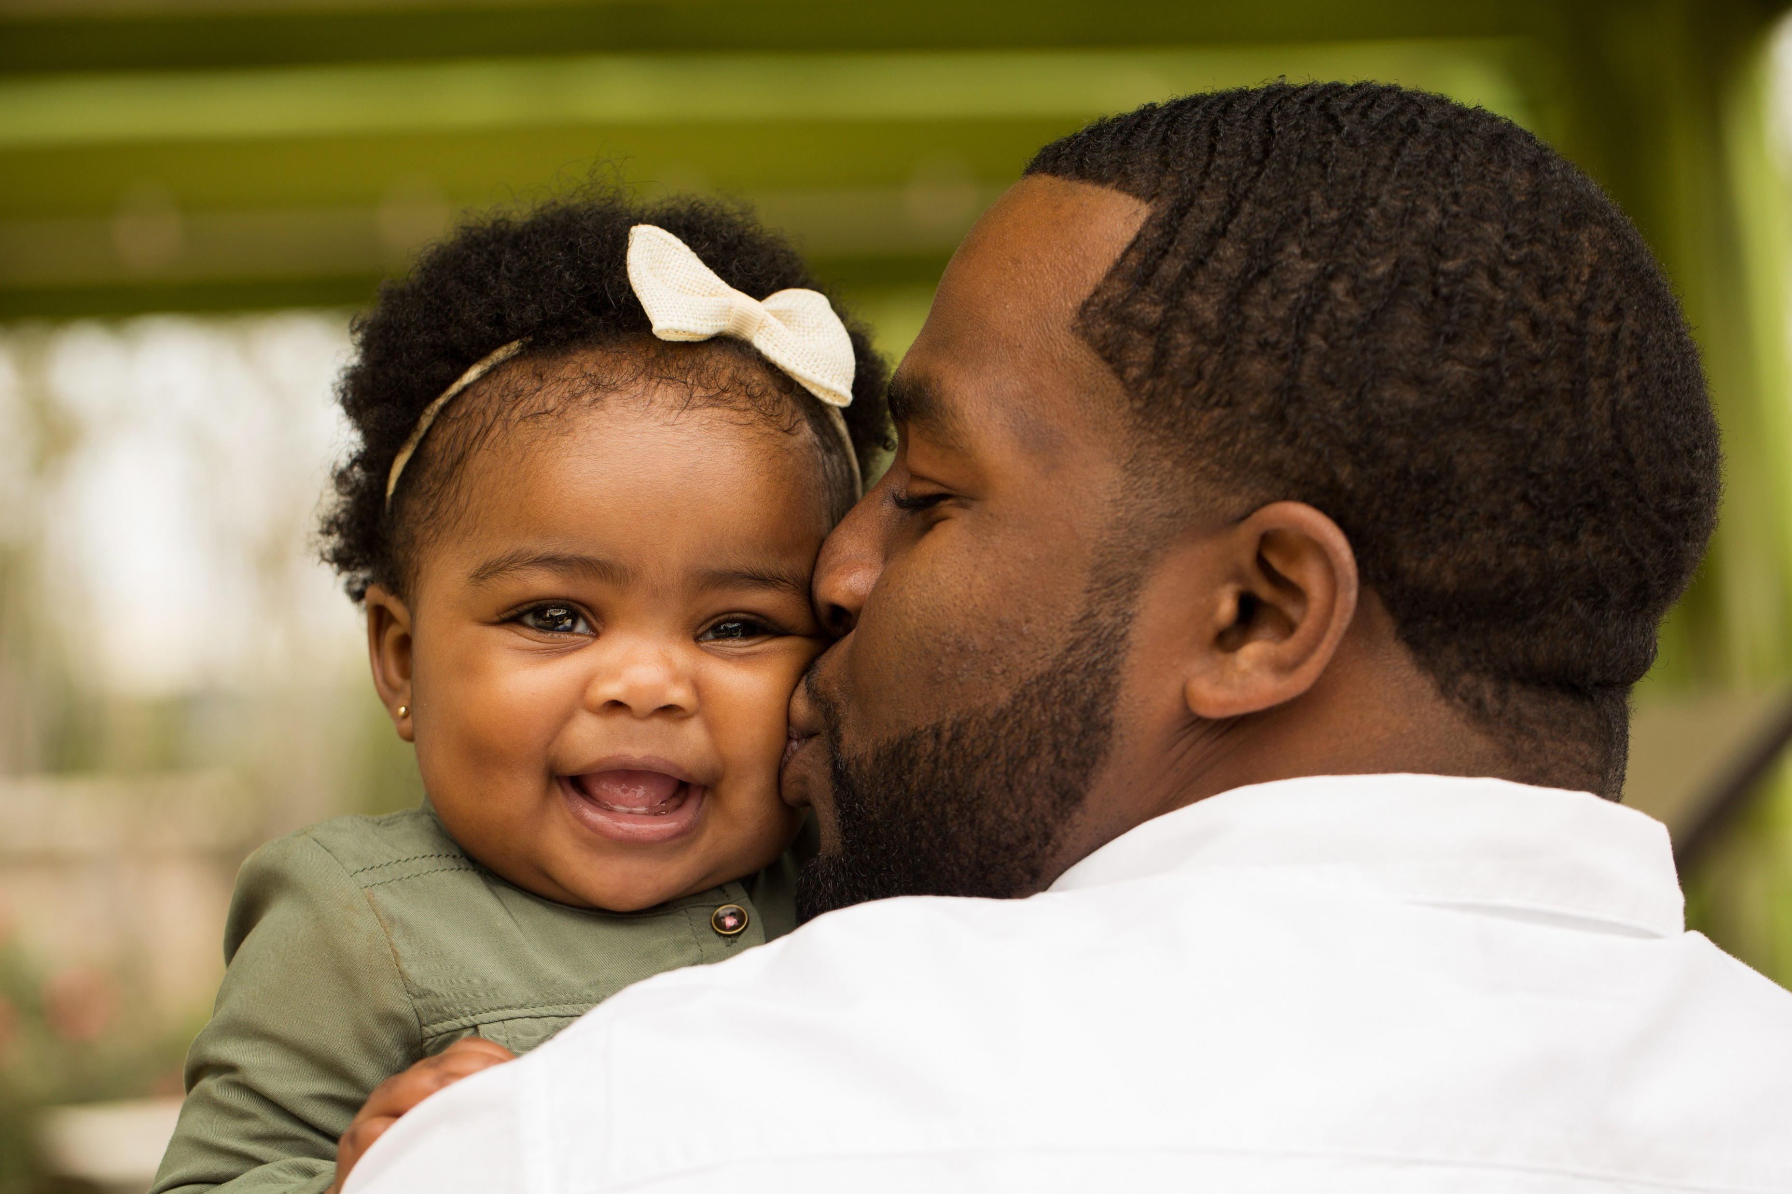
Preventing Infant Mortality
Did You Know?
The infant mortality rate for America’s Black babies is more than twice the rate of white babies.
Learn more:
nichq.org

