Slide 1
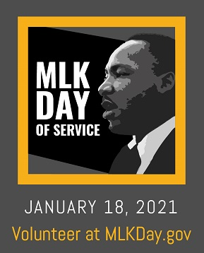
Martin Luther King, Jr. Day of Service:
January 18
Celebrate the Civil Rights leader’s life by serving on Martin Luther King Jr. Day of Service on Jan. 18.
By doing so, you help bring to life Dr. King’s vision of neighbors working together to build a better future.

