Slide 1

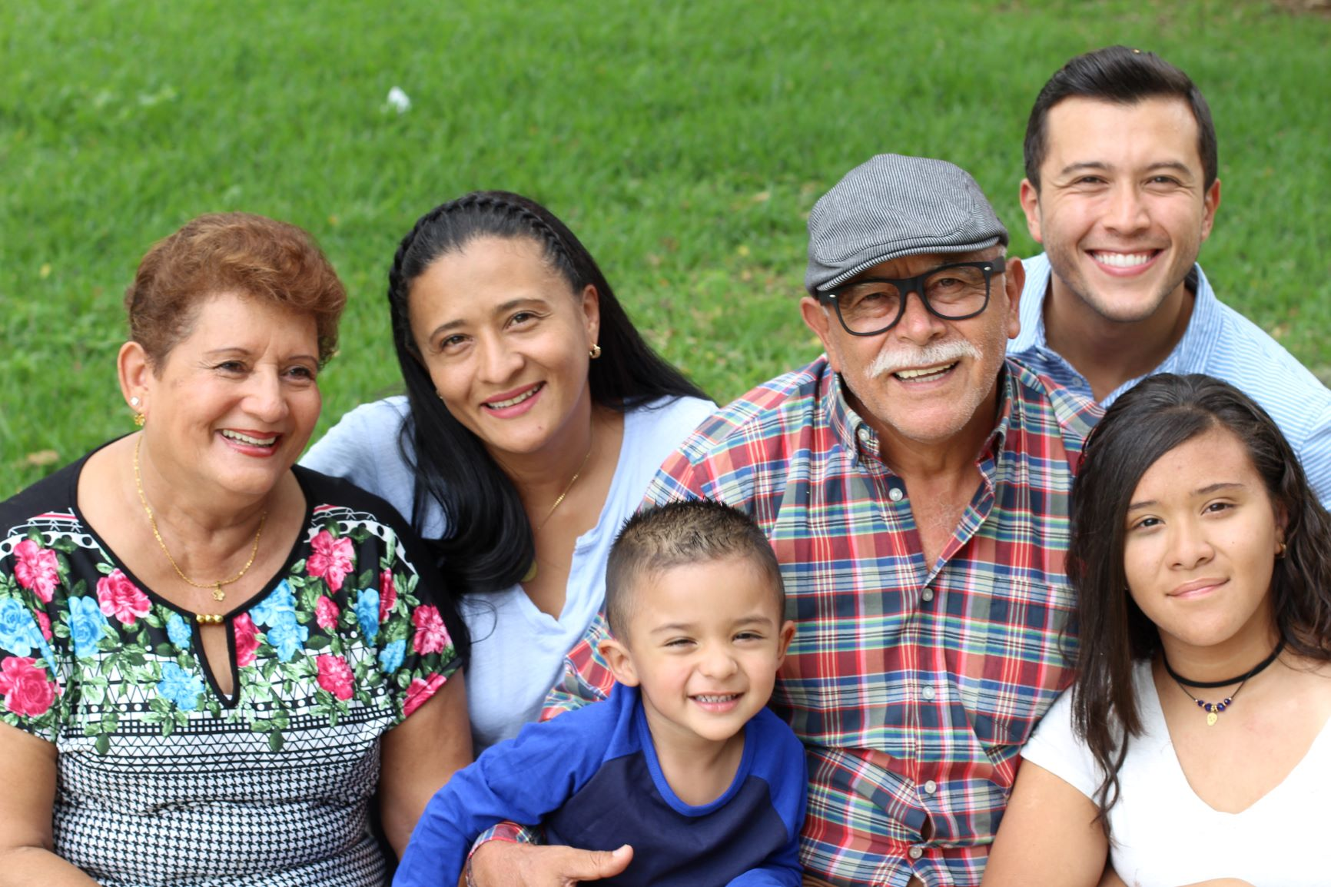

What is health equity?
Health equity means we all have a fair and just opportunity to be as healthy as possible, no matter who we are, where we live, or how much money we make.
Learn more: tinyurl.com/9n92hsav

