Slide 1
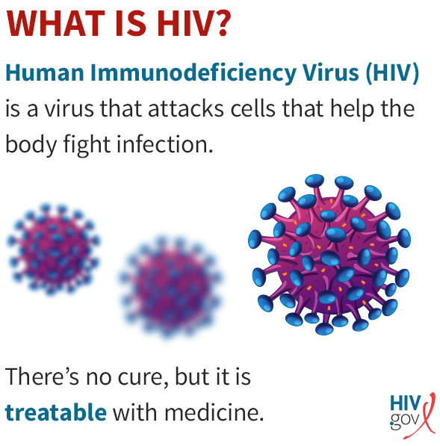
December is
HIV/AIDS Awareness Month
There are many ways to get involved:
Volunteer
Engage on social media
Keep learning
Share your knowledge
Participate in local events

